Slide 1


Arithmetic circuits: lower bounds, learning and applications
Ankit Garg,
Microsoft Research India

Slide 2
Outline
  Arithmetic circuits
  Learning arithmetic circuits
  Techniques
  Applications to machine learning
  Open Problems

Slide 3
Arithmetic circuits

Slide 4

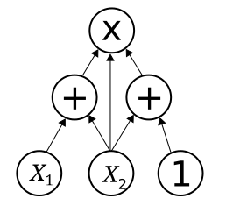



Arithmetic circuits
Variables: $x_{1},…,x_{n}$.
Input gates: Labelled by $x_{i}$ or a number.
Other gates: Labelled by $(+)$ or $\left(×\right)$.
Output gate(s): Output(s).
computes $\left(x_{1}+x_{2}\right)x_{2}(x_{2}+1)$.

Slide 5

Lower bounds
  [Valiant 79]: Complexity classes $VP$ and $VNP$.
  $VP$ : Polynomials computable by polynomial sized arithmetic circuits.
  $VNP$ : Arithmetic analogue of $NP$.
  Open question: $VP≠VNP$?
  Lot of progress for special circuit classes: depth-$3$, depth-$4$ etc.

Slide 6
Learning arithmetic circuits

Slide 7




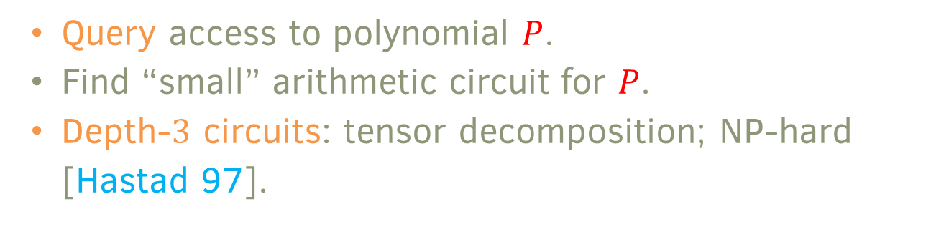
Learning arithmetic circuits
P
$$x_{1},…x_{n}$$
$$P(x_{1},…x_{n})$$
  Query access to polynomial $P$.
  Find “small” arithmetic circuit for $P$.
  Depth-$3$ circuits: tensor decomposition; NP-hard [Hastad 97].

Slide 8


Learning for non-degenerate circuits
  [Kayal, Saha 19; G, Kayal, Saha FOCS 20]: Meta framework.
What is non-degenerate case?
  Algorithms should handle most “reasonable” distributions.
  “Degenerate” inputs form a variety.
Lower bounds for circuit class $C$
Learning algorithms for $C$

Slide 9

Non-degenerate case learning: example​
  Symmetric tensor decomposition: $p\left(\underline{x}\right)=∑_{i=1}^{s}ℓ_{i}(\underline{x})^{3}$.
  [Hastad 97; Shitov 16]: NP-hard.
  [Jennrich 70,…]: If $s≤n$ and $ℓ_{1},…,ℓ_{s}$linearly independent, then can recover $ℓ_{i}$’s given $p$in polynomial time.
  Non-degeneracy condition: $ℓ_{i}$’s linearly independent.
  Number of summands roughly equal the best known lower bound.

Slide 10

Main result [G, Kayal, Saha 20] (Informal)
  Efficient algorithms for $p\left(\underline{x}\right)=∑_{i=1}^{s}Q_{i}(\underline{x})^{e}$in the non-degenerate case.
  $\deg\left(Q_{i}\right)=t≪e$
  $t=2$ relevant for mixture of Gaussians (method of moments).
  Substantially new techniques compared to $t=1$ (tensor decomposition).

Slide 11

Main result (formal)
  Theorem: There is a randomized polynomial time ($poly(n,s)$) algorithm that given query access to $p\left(\underline{x}\right)=∑_{i=1}^{s}Q_{i}(\underline{x})^{e}$, recovers the $Q_{i}$’s.
  Technical assumptions:
  $Q_{i}$’s “non-degenerate”. Satisfied if each coefficient chosen randomly from a large set.
  $n≥d^{2}$, $t=O(1)$, field size large enough.
  $s≤min⁡\{n^{d/O(1)}, 2^{n^{ε}}\}$.
Notes:
10 mins

Slide 12
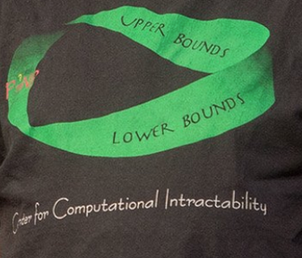
Algorithms from lower bounds
  Hardness vs Randomness [Nisan, Wigderson 96, …]
  Use of polynomial method [Williams 14, …]
  Learning Boolean circuits [Linial, Mansour, Nisan 95, …]
  Lower bounds: structure in circuit class.
  Structure: algorithms.

Slide 13
Techniques

Slide 14








Arithmetic Circuit Lower Bounds: Step 1
How to prove lower bounds for circuit class $C$?
Reduction to $p\left(\underline{x}\right)=T_{1}\left(\underline{x}\right)+⋯+T_{s}(\underline{x})$, $T_{i}$’s “simple” (lower bound on $s$).
Depth reduction or

Slide 15
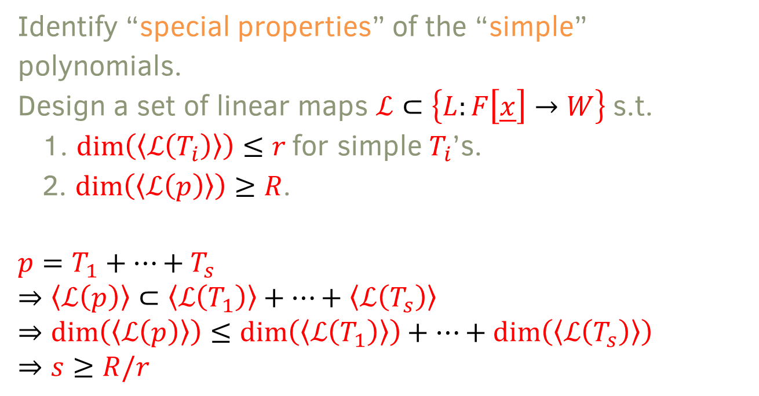
Arithmetic Circuit Lower Bounds: Step 2
Identify “special properties” of the “simple” polynomials.
Design a set of linear maps $ℒ⊂\left\{L:F\left[\underline{x}\right]→W\right\}$s.t.
  $\dim\left(\left\langle ℒ\left(T_{i}\right)\right\rangle \right)≤r$ for simple $T_{i}$’s.
  $\dim\left(\left\langle ℒ\left(p\right)\right\rangle \right)≥R$.
$$p=T_{1}+⋯+T_{s}$$
$$⇒\left\langle ℒ\left(p\right)\right\rangle ⊂\left\langle ℒ\left(T_{1}\right)\right\rangle +⋯+\left\langle ℒ\left(T_{s}\right)\right\rangle$$
$$⇒\dim\left(\left\langle ℒ\left(p\right)\right\rangle \right)≤\dim\left(\left\langle ℒ\left(T_{1}\right)\right\rangle \right)+⋯+\dim\left(\left\langle ℒ\left(T_{s}\right)\right\rangle \right)$$
$$⇒s≥R/r$$

Slide 16



Example
$p\left(\underline{x}\right)=ℓ_{1}{\left(\underline{x}\right)}^{3}+⋯+ℓ_{s}{\left(\underline{x}\right)}^{3}$($ℓ_{i}$’s linear).
$ℒ=\left\{∂_{x_{1}},…,∂_{x_{n}}\right\}$.
  1. $\dim\left(\left\langle ℒ\left(ℓ_{i}^{3}\right)\right\rangle \right)≤1$.
  2. $\dim\left(\left\langle ℒ\left(x_{1}^{3}+⋯x_{n}^{3}\right)\right\rangle \right)=n$.
For $p\left(\underline{x}\right)=x_{1}^{3}+⋯x_{n}^{3}$, $s≥n$.

Slide 17

Learning from lower bounds: intuition
  Lower bounds: $p\left(\underline{x}\right)=T_{1}\left(\underline{x}\right)+⋯+T_{s}(\underline{x})$,
  no other decomposition $p\left(\underline{x}\right)={T′}_{1}\left(\underline{x}\right)+⋯+{T′}_{s′}(\underline{x})$, with $s^{′}≪s$.
  Uniqueness: $p\left(\underline{x}\right)=T_{1}\left(\underline{x}\right)+⋯+T_{s}(\underline{x})$,
  no other decomposition $p\left(\underline{x}\right)={T′}_{1}\left(\underline{x}\right)+⋯+{T′}_{s′}(\underline{x})$, with $s^{′}≤s$.
  Proof of uniqueness key step in learning algorithms.
  Key insight: many lower bound proofs can be strengthened to uniqueness.

Slide 18
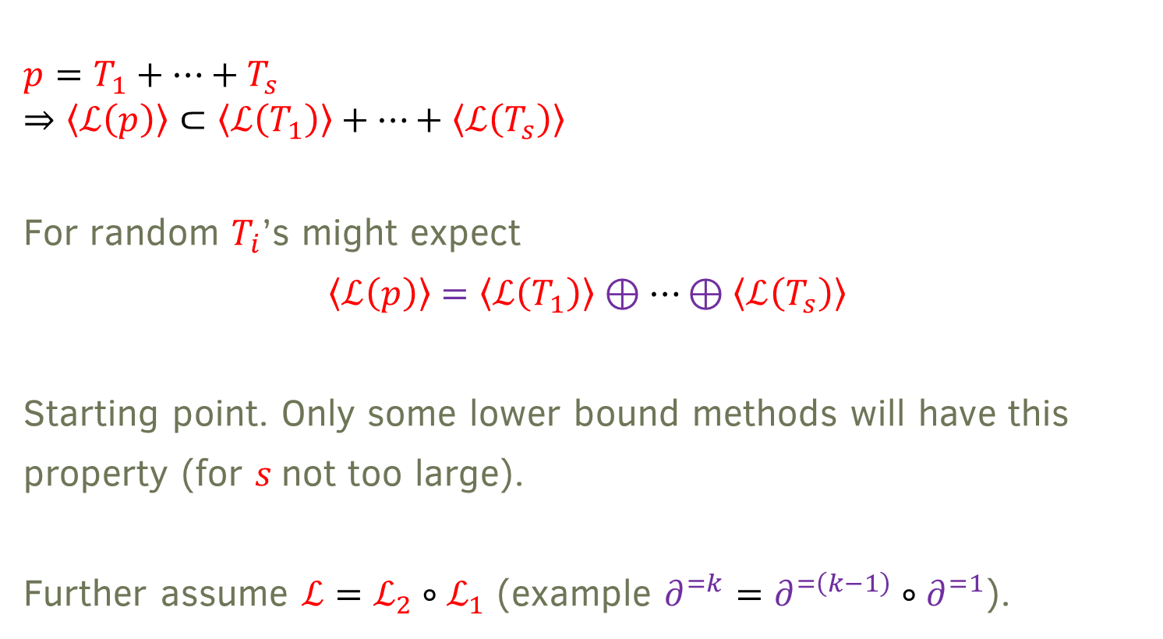
Meta framework for Learning
$$p=T_{1}+⋯+T_{s}$$
$$⇒\left\langle ℒ\left(p\right)\right\rangle ⊂\left\langle ℒ\left(T_{1}\right)\right\rangle +⋯+\left\langle ℒ\left(T_{s}\right)\right\rangle$$
For random $T_{i}$’s might expect
$$\left\langle ℒ\left(p\right)\right\rangle =\left\langle ℒ\left(T_{1}\right)\right\rangle ⊕⋯⊕\left\langle ℒ\left(T_{s}\right)\right\rangle$$
Starting point. Only some lower bound methods will have this property (for $s$not too large).
Further assume $ℒ=ℒ_{2}∘ℒ_{1}$ (example $∂^{=k}=∂^{=\left(k−1\right)}∘∂^{=1}$).

Slide 19



Meta framework
$p=T_{1}+⋯+T_{s}$
$\left\langle ℒ_{1}\left(p\right)\right\rangle =\left\langle ℒ_{1}\left(T_{1}\right)\right\rangle ⊕⋯⊕\left\langle ℒ_{1}\left(T_{s}\right)\right\rangle$
$\left\langle ℒ_{2}∘ℒ_{1}\left(p\right)\right\rangle =\left\langle ℒ_{2}∘ℒ_{1}\left(T_{1}\right)\right\rangle ⊕⋯⊕\left\langle ℒ_{2}∘ℒ_{1}\left(T_{s}\right)\right\rangle$
$$ℒ_{1}$$
$$ℒ_{2}$$

Slide 20



Meta Framework
$\left\langle ℒ_{1}\left(p\right)\right\rangle =\left\langle ℒ_{1}\left(T_{1}\right)\right\rangle ⊕⋯⊕\left\langle ℒ_{1}\left(T_{s}\right)\right\rangle$
$$\left\langle ℒ_{2}∘ℒ_{1}\left(p\right)\right\rangle =\left\langle ℒ_{2}∘ℒ_{1}\left(T_{1}\right)\right\rangle ⊕⋯⊕\left\langle ℒ_{2}∘ℒ_{1}\left(T_{s}\right)\right\rangle$$
Have access $\left\langle ℒ_{1}\left(p\right)\right\rangle$to and $\left\langle ℒ_{2}∘ℒ_{1}\left(p\right)\right\rangle$.
Vector space decomposition: $U=U_{1}⊕⋯⊕U_{s}$
$V=V_{1}⊕⋯⊕V_{s}$
$$ℒ_{2}$$
$$ℒ_{2}$$

Slide 21

Vector Space Decomposition
  Given $ℒ⊂\{L:U→V\}$, decompose $U=U_{1}⊕⋯⊕U_{s}$, $V=V_{1}⊕⋯⊕V_{s}$s.t. $ℒ\left(U_{i}\right)⊆V_{i}$ for all $i$. Further $(U_{i}, V_{i})$ indecomposable.
  “Simultaneous matrix block diagonalization”
  [Chistov, Karpinski, Ivanyos 97]: Polynomial time algorithms.
  Krull-Schmidt theorem: Characterizes all decompositions. For example, same $s$for all decompositions.
  For learning:
  Direct sum property.
  Uniqueness of decomposition.

Slide 22
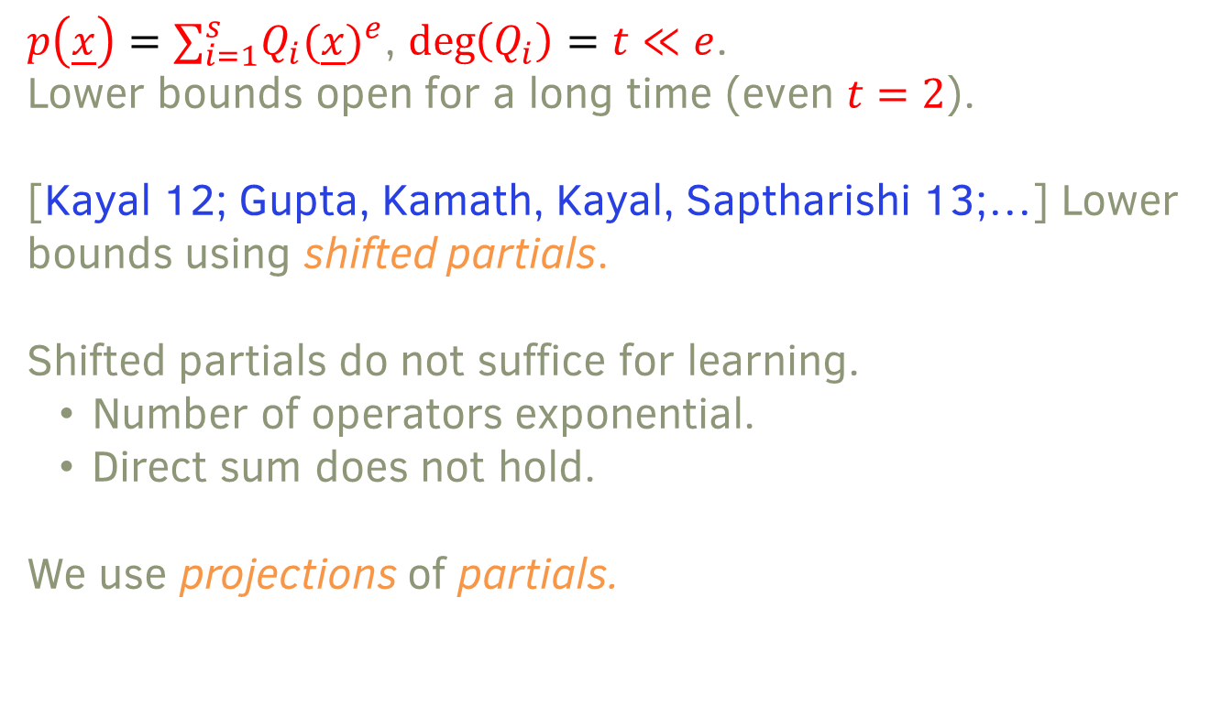
Instantiation
$p\left(\underline{x}\right)=∑_{i=1}^{s}Q_{i}(\underline{x})^{e}$, $\deg\left(Q_{i}\right)=t≪e$.
Lower bounds open for a long time (even $t=2$).
[Kayal 12; Gupta, Kamath, Kayal, Saptharishi 13;…] Lower bounds using shifted partials.
Shifted partials do not suffice for learning.
  Number of operators exponential.
  Direct sum does not hold.
We use projections of partials.
Notes:
25 mins

Slide 23
Applications

Slide 24
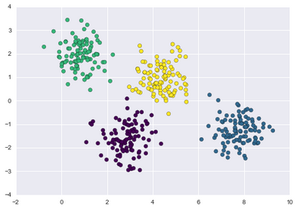
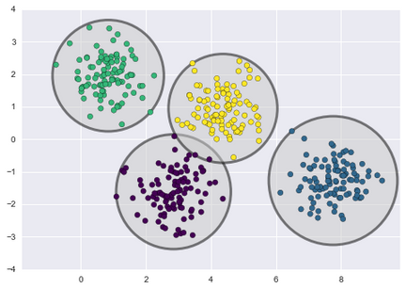
Mixtures of Gaussians
  Classical problem dating to [Pearson 1896].
  Input: Data from mixture of
  Gaussian distributions.
  Output: Parameters of individual
  Gaussians.
  Applications across scientific
  areas.

Slide 25
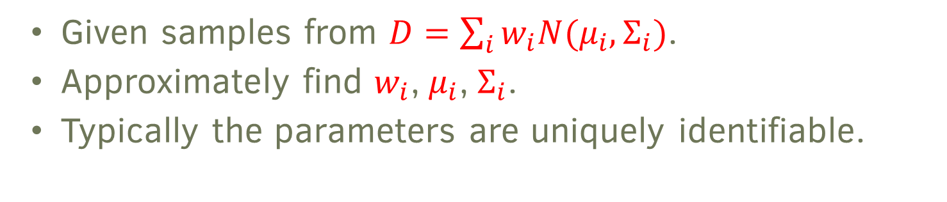
Mixtures of Gaussians
  Given samples from $D=\sum_{i}{w_{i}N(μ_{i}, Σ_{i})}$.
  Approximately find $w_{i}$, $μ_{i}$, $Σ_{i}$.
  Typically the parameters are uniquely identifiable.

Slide 26
Mixture of Gaussians: algorithms
  Expectation maximization: Works well in practice. Few theoretical guarantees [Dempster, Laird, Rubin 77;…].
  Spectral methods: Based on clustering. Need separation between parameters. [Dasgupta 99; Arora, Kannan 01; Vempala, Wang 04; Achlioptas, McSherry 05; Kannan, Salmasian, Vempala 08;…].
  Method of moments: Smoothed analysis [Belkin, Sinha 10; Moitra, Valiant 10; Hsu, Kakade 13; Anderson, Belkin, Goyal, Rademacher, Voss 13; Bhaskara, Charikar, Moitra, Vijayaraghavan 14; Ge, Huang, Kakade 15;…].

Slide 27
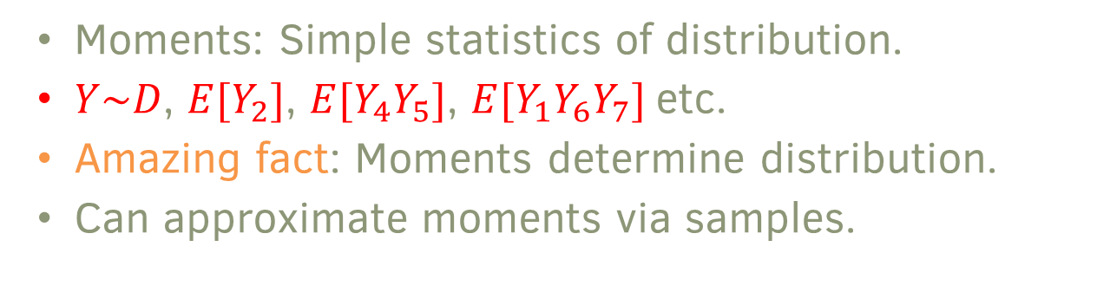
Method of moments
  Moments: Simple statistics of distribution.
  $Y\sim D$, $E[Y_{2}]$, $E[Y_{4}Y_{5}]$, $E[Y_{1}Y_{6}Y_{7}]$ etc.
  Amazing fact: Moments determine distribution.
  Can approximate moments via samples.

Slide 28
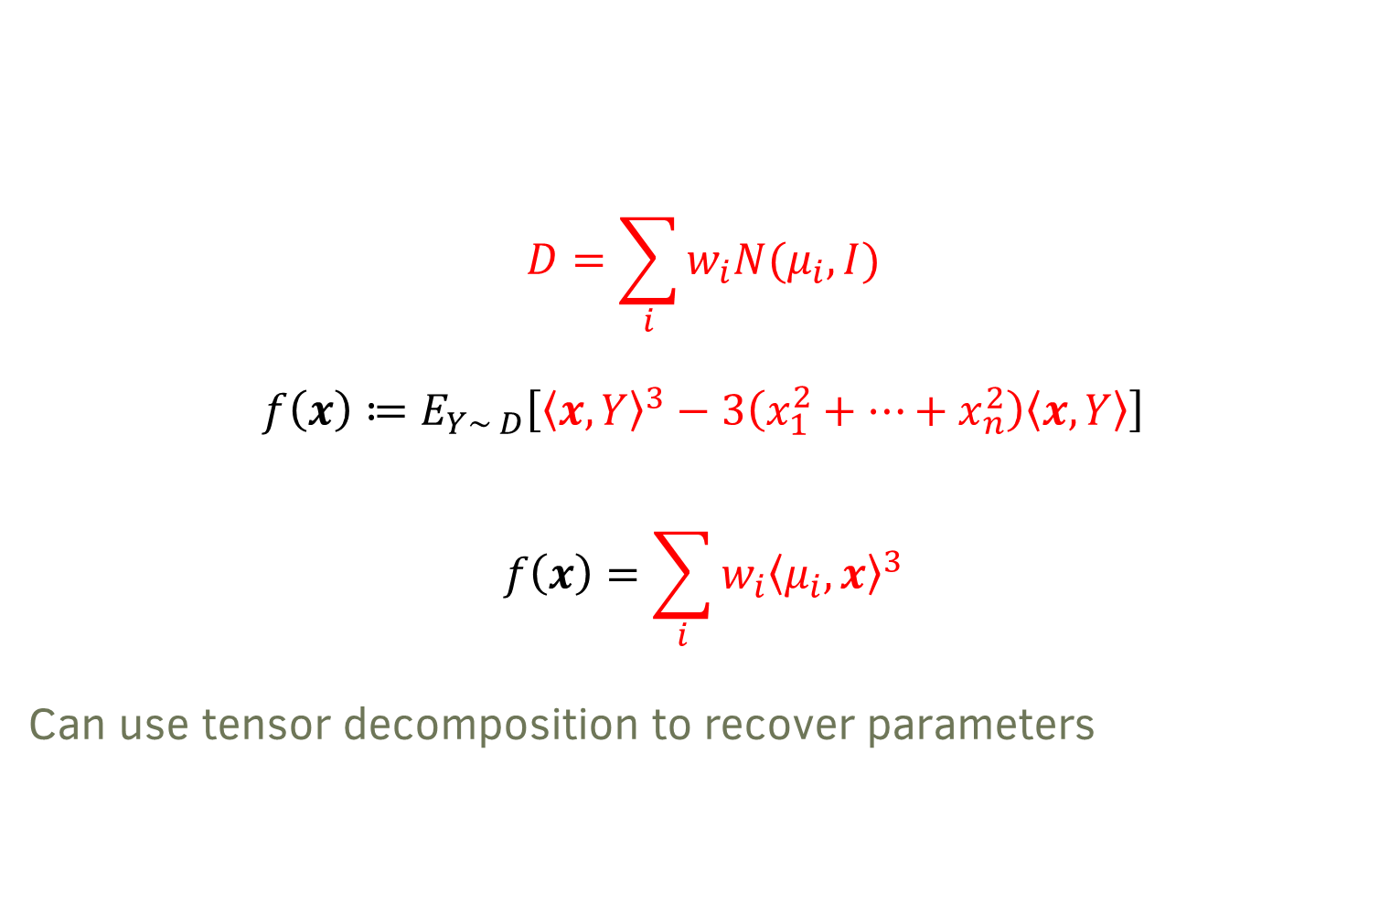
Spherical case
$$D=\sum_{i}{w_{i}N(μ_{i}, I)}$$
$$f\left(x\right)≔E_{Y\sim D}\left[{\left\langle x,Y\right\rangle }^{3}−3\left(x_{1}^{2}+⋯+x_{n}^{2}\right)\left\langle x,Y\right\rangle \right]$$
$$f\left(x\right)=\sum_{i}{w_{i}{\left\langle μ_{i},x\right\rangle }^{3}}$$
Can use tensor decomposition to recover parameters

Slide 29
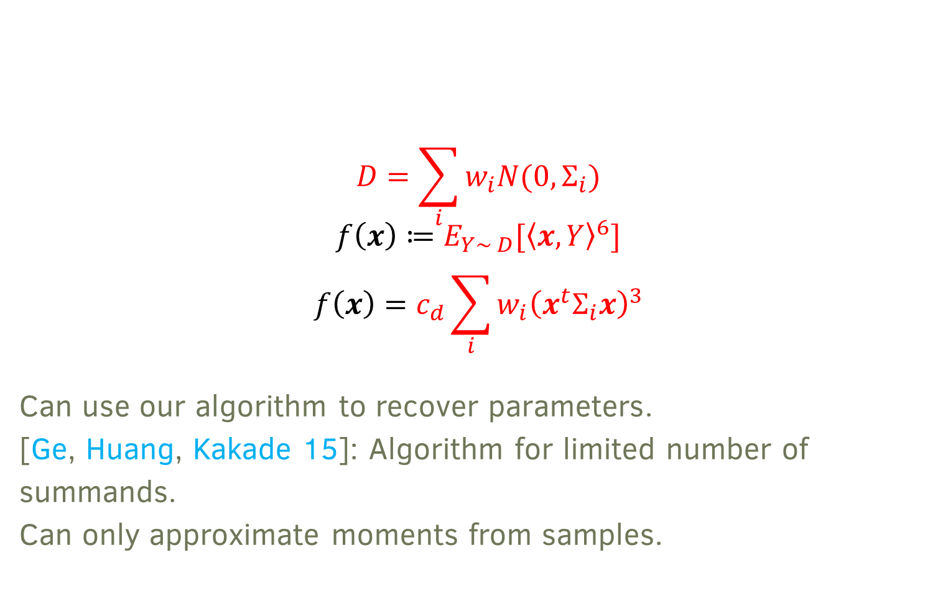
Zero mean case
$$D=\sum_{i}{w_{i}N(0, Σ_{i})}$$
$$f\left(x\right)≔E_{Y\sim D}[{\left\langle x,Y\right\rangle }^{6}]$$
$$f\left(x\right)=c_{d}\sum_{i}{w_{i}{\left(x^{t}Σ_{i}x\right)}^{3}}$$
Can use our algorithm to recover parameters.
[Ge, Huang, Kakade 15]: Algorithm for limited number of summands.
Can only approximate moments from samples.

Slide 30
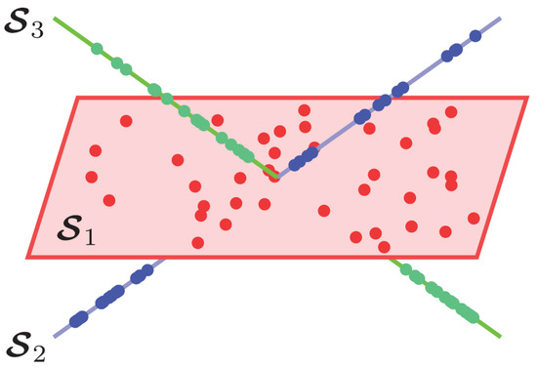
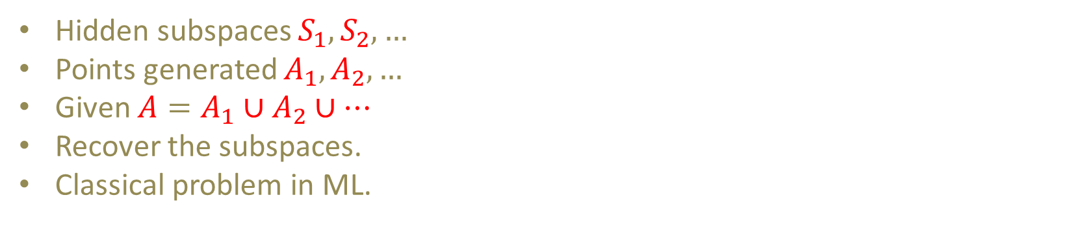
Subspace clustering
Hidden subspaces $S_{1}, S_{2},…$
Points generated $A_{1},A_{2},…$
Given $A=A_{1}∪A_{2}∪⋯$
Recover the subspaces.
Classical problem in ML.
Notes:
35 mins

Slide 31

Learning arithmetic circuits with noise
  Given $p\left(\underline{x}\right)+ε(\underline{x})$, find a small circuit approximately computing $p(\underline{x})$.
  [Chandra, G, Kayal, Mittal, Sinha 24]: Extend meta framework to the noisy setting.
  Noiseless case: Non-degeneracy conditions
  Noisy case: Smoothed analysis
  [Chandra, G, Kayal, Mittal, Sinha 24]: Proposed algorithms for subspace clustering and mixtures of zero-mean Gaussians in the smoothed setting.
  Analysis for subspace clustering based on conjectures about condition numbers of smoothed matrices.

Slide 32

Follow up work
  [Bafna, Hsieh, Kothari, Xu 22]: Algorithm and analysis for $p\left(\underline{x}\right)=∑_{i=1}^{s}Q_{i}(\underline{x})^{e}+ε(\underline{x})$ in random case.
  Adapt [GKS 20] algorithm to work in noisy case.
  [Bhaskara, Evert, Srinivas, Vijayaraghavan 24]: Analysis of [BHKX 22] algorithm in the smoothed case.
  Also resolve the conjectures for smoothed analysis of subspace clustering.
  [Koiran 24]: Tensor decomposition for $n×n×n$ tensors in non-degenerate case. Rank up to $4n/3$.
  Inspired by lower bounds but doesn’t use our framework.
  [Kothari, Moitra, Wein 24]: Tensor decomposition for $n×n×n$ tensors in non-degenerate case. Rank up to $\left(2−ε\right)n$.
  Uses our framework with Kozsul-Young flattenings.

Slide 33
Open Problems

Slide 34
Open problems
  Learning algorithms for more classes of arithmetic circuits, e.g. constant depth circuits.
  More applications in ML (beyond tensor decomposition).
  Smoothed analysis of mixtures of Gaussians.

Slide 35

Open problems
  Exciting interplay of algorithms, complexity and machine learning!
  Tensor decomposition for $n×n×n$ tensors.
  Open: rank $n^{1.1}$lower bound.
  Also open: Tensor decomposition for rank $n^{1.1}$(non-degenerate).
  [EGOW 17]: rank lower bound cannot be proven by known techniques.

Slide 36
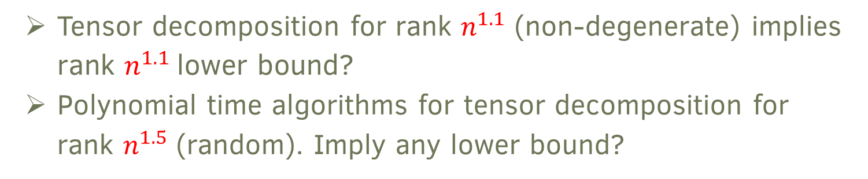
Open problems
  Tensor decomposition for rank $n^{1.1}$ (non-degenerate) implies rank $n^{1.1}$lower bound?
  Polynomial time algorithms for tensor decomposition for rank $n^{1.5}$ (random). Imply any lower bound?
Notes:
45 mins

Slide 37
Thank You

